Slide 1
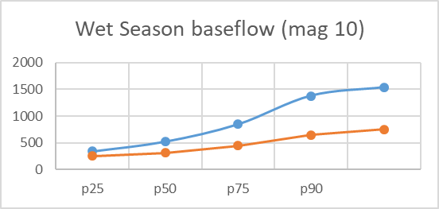
Wet Season Baseflow – Tuolumne (La Grange)
Suggests adjusting wet season magnitude to mag-10 or 50% mag-10 if flows are to stay in channel
Additional Rules:
Continues from Feb 1 until spring recession ramp up date, which is back-calculated from spring recession magnitude start date. (ramp up approximately 2 weeks)
DWR Predicted FF Metrics – All years
Wet Season Baseflow
 | p10 | p25 | p50 | p75 | p90
wet_bfl_dur | 87 | 119.5 | 137 | 191.5 | 206.2
wet_bfl_mag_10 | 344.77 | 526.7 | 849.4 | 1378.1 | 1534.72
wet_bfl_mag_50 | 1427.8 | 2153.5 | 3002 | 4654 | 5658.8
wet_tim | 44.2 | 57 | 96 | 121.5 | 137.8
Approximate Flow Volume required for adjusted p50: 893 af per day
Feb 1 – Apr 30: 80 taf
Adjusted Wet Season (Mag_10) (scaled %)
75% |  | 60% | 55% | 50% | 50%
P10 |  | P25 | P50 | P75 | P90
 | 255 | 315 | 450 | 650 | 750
Notes:
Following CDFW disc on Nov 20 – adjust to 50% of predicted, except 75% of p10, p25? Want to get up to 500cfs in most years, with not to much below that in drier years.

Slide 2
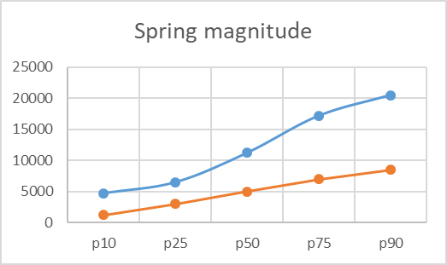
Spring Recession Flow – Tuolumne (La Grange)
DWR Predicted FF Metrics – All years
Suggests adjusting spring magnitude to ~1000cfs - 9000cfs
Additional Rules:
Ramp down 7% all years – calculated ROC for DWS is incorrect due to daily modeling errors
Ramp up at double recession rate (or 13%) (back calculate start date from recession start date)
Ramp rates account for duration
Timing – might be able to start ramp up at centroid timing date
Spring Recession Flow
 | p10 | p25 | P50 | p75 | p90
sp_dur | 40.2 | 52.5 | 60 | 65.5 | 75
sp_mag | 4731.8 | 6501.5 | 11210 | 17165 | 20468.8
sp_roc | 0.11 | 0.12 | 0.153 | 0.19 | 0.22
sp_tim | 221.6 | 230.5 | 239 | 254 | 263.2
 | 9-May | 18-May | 27-May | 11-Jun | 20-Jun
Adjusted Spring Mag – All years
Approximate Flow Volume required for adjusted p50:
spring ramp down: 175 taf
spring ramp up: 75 taf
P10 |  | P25 | p50 | p75 | P90
 | 1250 | 3000 | 5000 | 7000 | 8500
Notes:
Following CDFW discussion – adjust to 1200 cfs to 9000 cfs range.

Slide 3
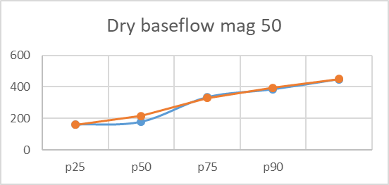
Dry Season Baseflow – Tuolumne (La Grange)
Suggests adjusting dry season magnitude to ~ 100% mag-50
Additional Rules:
Continues from end of spring ramp down until Oct 1 (and/or fall pulse)
DWR Predicted FF Metrics – All years
Dry Season baseflow
 | p10 | p25 | p50 | p75 | p90
ds_dur_ws | 117.8 | 140 | 171 | 179.5 | 196.2
ds_mag_50 | 160.18 | 177.47 | 333 | 383.5 | 447
ds_mag_90 | 373.81 | 590.5 | 928 | 1250.9 | 1565.2
ds_tim | 272.8 | 282 | 300 | 316 | 327.4
Approximate Flow Volume required for adjusted p50 July 1 – Oct 1:
- Flow is approximately 350 cfs baseline, no extra water needed
- full p50 (330 cfs) = 60 taf
Adjusted Dry Season (Mag_50) (scale %)
100% |  | 120% | 100% | 100% | 100%
P10 |  | P25 | P50 | P75 | P90
 | 160 | 215 | 330 | 395 | 450

Slide 4
Tuolumne Estimated FF Volumes
2018 WY (average) - 40% unimpaired Feb-June = 512 taf
Spring pulse (p50) ramp up/down may 15 - June 30 = 250 taf
wet season baseflow (p50) feb-apr = 80-100 taf
fall pulse flow (p50) = 10-15 taf
summer baseflow (extra 100 cfs per day over 350 cfs baseline) July 1-Oct 1 = 18 taf
summer baseflow (p50 = 330) July 1-Oct 1 = 60-65 taf
TOTAL baseflows + spring pulse/recession flow + fall pulse flow (Feb 1 – Oct 15) ~ 400-430 taf

Slide 5
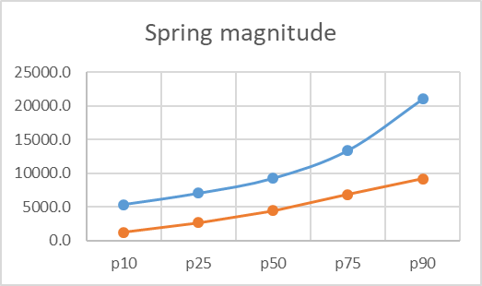
Spring Recession Flow – Tuolumne (La Grange)
TNC Predicted FF Metrics – All years
Channel Capacity Info:
Overbank flow occurs at 1,100-3,200 cfs
Maximum flow for power generation is 5,500 cfs
Channel capacity through downtown Modesto is 10,000 cfs; army corp uses 9k
Channel capacity for entire river is 15,000 cfs
Extensive flooding occurs at 40,000 cfs
Gravel transport in upper reaches begins at 7,000-9,800 cfs
Overbank habitat for juvenile salmonids increases most rapidly 1,000-3,000 cfs; increases up to 5,000 cfs (max flow modeled).
Suggests adjusting spring magnitude to 1000cfs - 9000cfs
Spring Recession Flow
 | p10 | p25 | p50 | p75 | p90
sp_dur | 44.7 | 53.4 | 64.0 | 78.6 | 100.7
sp_mag | 5381.9 | 7048.0 | 9277.6 | 13413.3 | 21034.5
sp_roc | 0.011 | 0.014 | 0.042 | 0.057 | 0.060
sp_tim | 211.7 | 227.2 | 239.0 | 246.0 | 254.5
 | 30-Apr | 15-May | 27-May | 3-Jun | 12-Jun
Adjusted Spring Mag – All years
P10 |  | P25 | p50 | p75 | P90
 | 1221 | 2668 | 4460 | 6843 | 9209

Slide 6
Spring Recession Flow – Tuolumne (La Grange)
TNC Predicted FF Metrics – All years
Suggests adjusting spring magnitude to ~1000cfs - 9000cfs
Additional Rules:
Ramp down at recession rate (or 6% all years)
Ramp up at double recession rate (or 13%) (back calculate start date from recession start date)
Ramp rates account for duration
Timing – might be able to start ramp up at centroid timing date
Spring Recession Flow
 | p10 | p25 | p50 | p75 | p90
sp_dur | 44.7 | 53.4 | 64.0 | 78.6 | 100.7
sp_mag | 5381.9 | 7048.0 | 9277.6 | 13413.3 | 21034.5
sp_roc | 0.011 | 0.014 | 0.042 | 0.057 | 0.060
sp_tim | 211.7 | 227.2 | 239.0 | 246.0 | 254.5
 | 30-Apr | 15-May | 27-May | 3-Jun | 12-Jun
Adjusted Spring Mag – All years
Approximate Flow Volume required for adjusted p50:
spring ramp down: 175 taf
spring ramp up: 75 taf
P10 |  | P25 | p50 | p75 | P90
 | 1221 | 2668 | 4460 | 6843 | 9209
Notes:
Following CDFW discussion – adjust to 1200 cfs to 9000 cfs range.

Slide 7
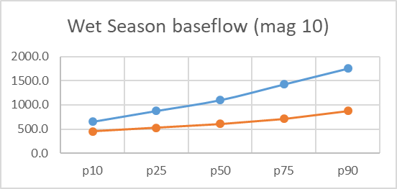
Wet Season Baseflow – Tuolumne (La Grange)
Fish Habitat Info:
naturally mag-50 is reached by mid-Feb (see willis et al paper)
current proposed Jan-Feb FERC flows = 225 cfs
current proposed Oct 16-Dec FERC flows = 275 cfs
Current FERC flows 150 cfs (BN, D) to 300 cfs (AN, W)
Jan-Mar - spawning/rearing chinook; spawning/rearing steelhead
WUA Omykiss curves Juv: 100-500cfs (80%), 500-1000cfs (70%);
WUA Omykiss curve adult: 200-500 cfs (80-100%), >500cfs (100%)
Assumes in channel flows only until spring
Suggests adjusting wet season magnitude to mag-10 or 50% mag-10 if flows are to stay in channel
TNC Predicted FF Metrics – All years
Wet Season Baseflow
 | p10 | p25 | p50 | p75 | p90
wet_bfl_dur | 71.4 | 95.2 | 127.4 | 158.5 | 185.3
wet_bfl_mag_10 | 651.5 | 877.0 | 1100.4 | 1427.4 | 1755.0
wet_bfl_mag_50 | 1808.9 | 2405.3 | 3131.9 | 4035.9 | 5113.4
wet_tim | 48.4 | 75.5 | 94.7 | 114.5 | 136.6
Adjusted Wet Season (Mag_10) (scaled %)
70% |  | 60% | 55% | 50% | 50%
P10 |  | P25 | P50 | P75 | P90
 | 326 | 438 | 550 | 714 | 878

Slide 8
Wet Season Baseflow – Tuolumne (La Grange)
Suggests adjusting wet season magnitude to mag-10 or 50% mag-10 if flows are to stay in channel
Additional Rules:
Continues from Feb 1 until spring recession ramp up date, which is back-calculated from spring recession magnitude start date. (ramp up approximately 2 weeks)
TNC Predicted FF Metrics – All years
Wet Season Baseflow
 | p10 | p25 | p50 | p75 | p90
wet_bfl_dur | 71.4 | 95.2 | 127.4 | 158.5 | 185.3
wet_bfl_mag_10 | 651.5 | 877.0 | 1100.4 | 1427.4 | 1755.0
wet_bfl_mag_50 | 1808.9 | 2405.3 | 3131.9 | 4035.9 | 5113.4
wet_tim | 48.4 | 75.5 | 94.7 | 114.5 | 136.6
Approximate Flow Volume required for adjusted p50:
Feb 1 – Apr 30: 107 taf
Adjusted Wet Season (Mag_10) (scaled %)
70% |  | 60% | 55% | 50% | 50%
P10 |  | P25 | P50 | P75 | P90
 | 326 | 438 | 550 | 714 | 878
Notes:
Following CDFW disc on Nov 20 – adjust to 50% of predicted, except 75% of p10, p25? Want to get up to 500cfs in most years, with not to much below that in drier years.

Slide 9
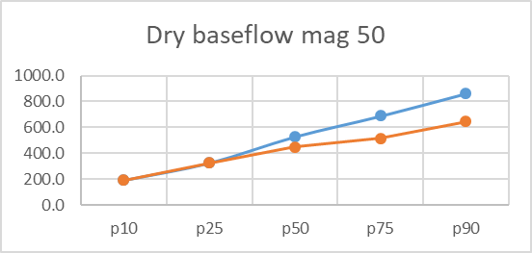
Dry Season Baseflow – Tuolumne (La Grange)
Fish Habitat Info:
Summer (July-Sept) flows between 100-250 cfs maintain rearing/spawning habitat to RM 43, with 175 cfs or greater maintaining temps
FERC Proposed 350 cfs at La Grange Gage and 150 cfs at RM 25.5 (below diversion dam)
Current FERC flows are 75 cfs (BN, D) & 250cfs (AN, W)
Jul-Oct - rearing, adult migration, need temps to be 18C or less ideally
Flows >400 cfs keep temps <20C to RM 39 (la grange at RM 52)
Suggests adjusting dry season magnitude to 100% mag-50 or 75% mag-50
TNC Predicted FF Metrics – All years
Dry Season baseflow
 | p10 | p25 | p50 | p75 | p90
ds_dur_ws | 108.5 | 131.1 | 160.6 | 187.2 | 214.9
ds_mag_50 | 190.9 | 324.7 | 528.0 | 688.4 | 862.6
ds_mag_90 | 383.3 | 580.7 | 902.7 | 1277.0 | 1678.4
ds_tim | 283.2 | 291.8 | 302.0 | 315.4 | 333.6
Adjusted Dry Season (Mag_50) (scale %)
100% |  | 100% | 85% | 75% | 75%
P10 |  | P25 | P50 | P75 | P90
 | 191 | 325 | 449 | 516 | 647
Notes:
Following discussion with CDFW on Nov 20 – may want to keep p10, p25 as natural, and do 75% of p50-p90

Slide 10
Dry Season Baseflow – Tuolumne (La Grange)
Suggests adjusting dry season magnitude to 100% mag-50 or 75% mag-50
Additional Rules:
Continues from end of spring ramp down until Oct 1 (and/or fall pulse)
TNC Predicted FF Metrics – All years
Dry Season baseflow
 | p10 | p25 | p50 | p75 | p90
ds_dur_ws | 108.5 | 131.1 | 160.6 | 187.2 | 214.9
ds_mag_50 | 190.9 | 324.7 | 528.0 | 688.4 | 862.6
ds_mag_90 | 383.3 | 580.7 | 902.7 | 1277.0 | 1678.4
ds_tim | 283.2 | 291.8 | 302.0 | 315.4 | 333.6
Approximate Flow Volume required for adjusted p50
July 1 – Oct 1:
- extra 100 cfs per day over 350 cfs baseline = 18 taf
- full p50 (450 cfs) = 82 taf
Adjusted Dry Season (Mag_50) (scale %)
100% |  | 100% | 85% | 75% | 75%
P10 |  | P25 | P50 | P75 | P90
 | 191 | 325 | 449 | 516 | 647

Slide 11
Rule set for implementing FF metrics/criteria (Willis et al. FES)

Slide 12
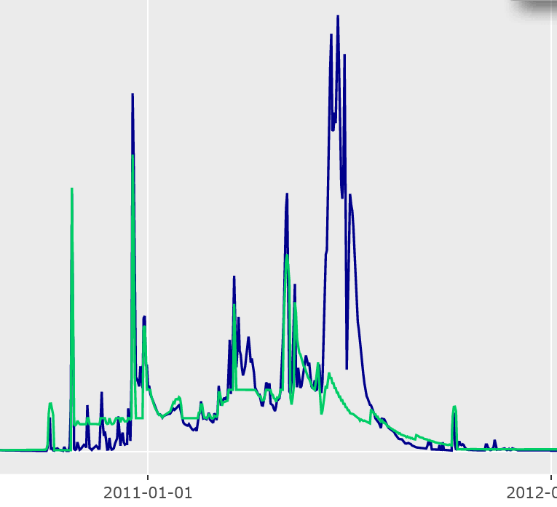
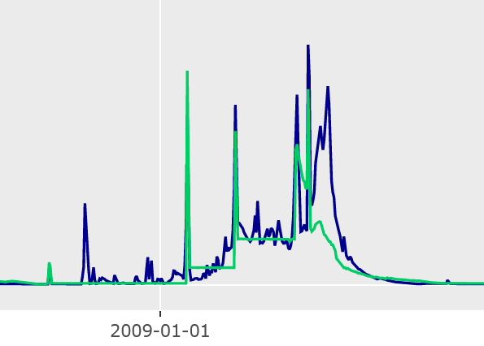
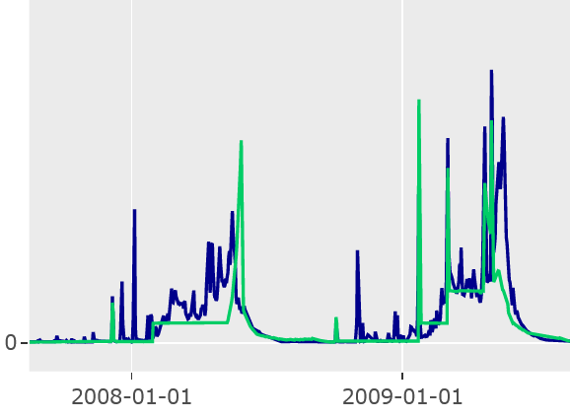

Modeled E-flow Scenarios (Willis et al. FES)
Merced River – Eflow Scenarios
Tuolumne River – Eflow Scenarios
32645-
Wet (cfs)
0-
2011-01-01
17500-
mod (cfs)
0-
2009-01-01
14550-
dry (cfs)
0-
2008-01-01

Slide 13
Modeled E-flow Scenarios (Willis et al. FES)

